Slide 1









TEAM DETAILS AND PROBLEM STATEMENT
Problem Statement : Global Article Summarization and Link Analysis Platform
Team Name : AINNOVATORS
Team Leader Details (Name, Phone Number, Email) : SAHIL CHANDAN KULKARNI
8329076760
kulkarnisahil882@gmail.com
Institution Name : K.K. Wagh Institute Of Engineering, Education and Research, Nashik
Course Enrolled : Computer Engineering (B.Tech)

Slide 2


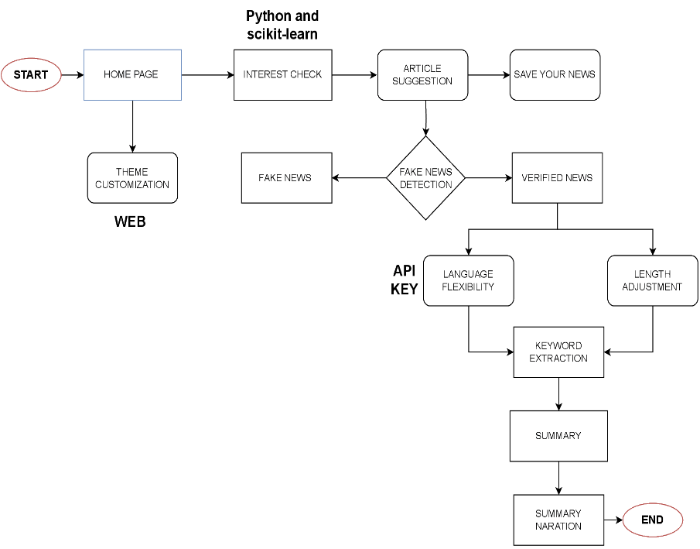
Problem Statement:
Problem 1 - Global Article Summarization and Link Analysis Platform
Objectives:
Efficient model to filter Articles using NLP techniques for relevance and accuracy
Summarization model allowing user to adjust length and language of summary
Summary of not only Text but also the visuals(audio, video, pictures, charts) included in an Article
Related Fake News Detection
Article Suggestion
Customizable UI Interface (Theme Customization)
Flowchart:
Flowchart link

Slide 3
Methodology:
Algorithm to Extract pictures, videos From articles
NLP(SpaCy) and ML(NER) model for summarization, length adjustment and Fake news Detection
Model Training
Illustration of AI to detect Relationship between Articles
Implementing user Friendly UI Interface
Use Case :
Actor 1: User
Use case 1: Summary with required Requirements
Goal: Identifying user’s interest, Detecting whether news is fake or not, providing summary of news with language and length flexibility.
Actor 2: System
Use case 1: Query Processing, suggestion of relevant Articles
Goal: Understanding user’s Interest and providing relevant material using AI techniques
Use case 2: Customized Summarization, presentation
Goal: Customized summarization based on user’s preference in terms of length, language and Selective presentation of UI interface.
Future Aspect:
Text to Speech feature to allow users to listen Summary, Articles
Community Forum where users with similar interest can discuss
Take a note feature to create, organize and search notes efficiently

Slide 4







TEAM AINNOVATORS:
Team Leader Name: Sahil Kulkarni
Branch: B.Tech Stream : Computer Engineering Year : SE
Expertise: AI
Team Member 1 Name: Samyak Raka
Branch: B.Tech Stream : Computer Engineering Year : SE
Team Member 2 Name: Vedant Joshi
Branch: B.Tech Stream : Computer Engineering Year: SE
Team Member 3 Name: Ishwari Sangle
Branch: B.Tech Stream : IT Engineering Year: SE Expertise:

